Slide 1
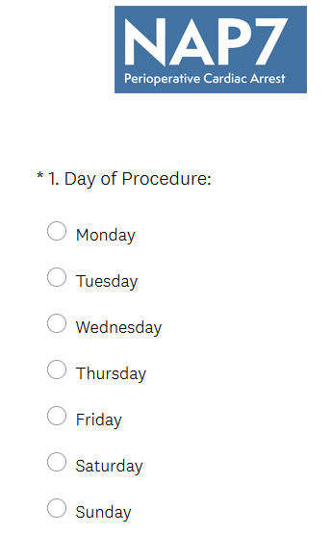
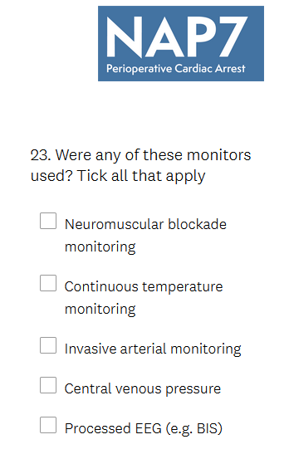
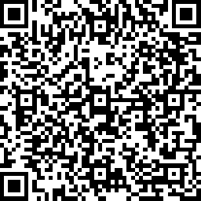
Quick Guide to Completing the NAP7 Activity Survey
An asterisk means the question is compulsory
1. Click the link sent to you by your NAP7 Local Coordinator on any PC, tablet or smartphone.
Circles mean select one option
2. Work through the survey electronically at the end of each case.
3. Repeat the survey for each case completed. Only 1 survey per case should be completed- where more than one anaesthetist is present agree who will complete the survey.
Squares allow multiple responses
4. The survey has inbuilt logic and so you may see different questions each time you complete it depending on your responses. Don’t be alarmed!
5. QR link to survey is here
6. Or survey link is here
All cases under the care of an anaesthetist during the period are to be included.
This includes cases under general anaesthesia, regional anaesthesia/analgesia, sedation, local anaesthesia, or monitored anaesthesia care.
Don’t forget to record:
• Emergency and trauma theatres
• Labour ward- include labour ward interventions as separate cases
• Anaesthesia away from your main site- e.g. day surgery unit, ECT
• Pain procedures that occur in operating theatres or pain clinic
• Diagnostic and interventional radiology, cardiac cath labs etc
• Emergency anaesthesia or sedation in the emergency department for a procedure if administered by an anaesthetist
• Out of hours work, including extra elective lists at the weekend.
Your survey dates are ____ to ___ November 2021, from midnight to midnight.

